Slide 1
Devanagari Handwritten Character Recognition
Team Members :
Ramkrishna Acharya
Abhishek Gupta
Kamal Gautam
Arjun Gautam

Slide 2
Contents
Problem Definition
Introduction to the Project
Application of the Project
Platform Used
Steps In DCR
Working of DCR
Future Enhancements and Prospects
Summary

Slide 3
Problem Definition
Number of research on Computer Vision in Nepal.
Complexity of the Devanagari Characters.
Making computer understand our Nepali language.

Slide 4
Introduction
Works on real time using camera or local image
Converts found text image to digital text
Recognizes only Devanagari characters, numerals and simple words
Based on techniques of Convolutional Neural Network and Image Processing

Slide 5
Objectives
To develop a system that recognize the Devanagari Character on Image from local or camera image
To develop a system that recognize the Devanagari Character on Real time
To build a new research techniques of Optical Character Recognition for Devanagari Character Recognition

Slide 6
Scope and Applications
Improve of human computer interface for computer illiterate people by providing various computing services on inputs
The system can create paperless environment by digitizing handwritten character

Slide 7
Features
User can write the Devanagari character on their own styles
Output will be displayed as a digital text

Slide 8
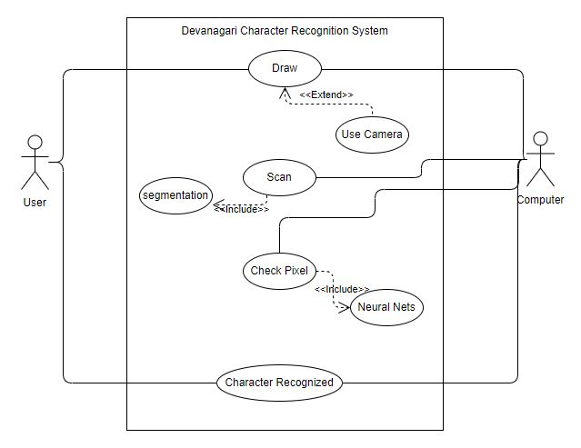
Use Case Diagram

Slide 9
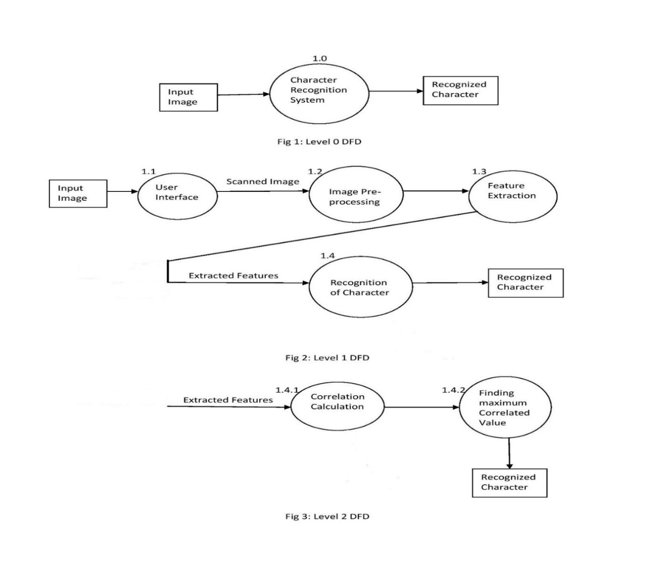
Data Flow Diagram

Slide 10
Methodology
Training
Pre-processing
Create model
Train model
Test model
Save model
Character Recognition
Image Acquisition
Pre-processing
Feature Extraction
Segmentation
Detection(Character/Noise)
Prediction
Localization
Post processing

Slide 11
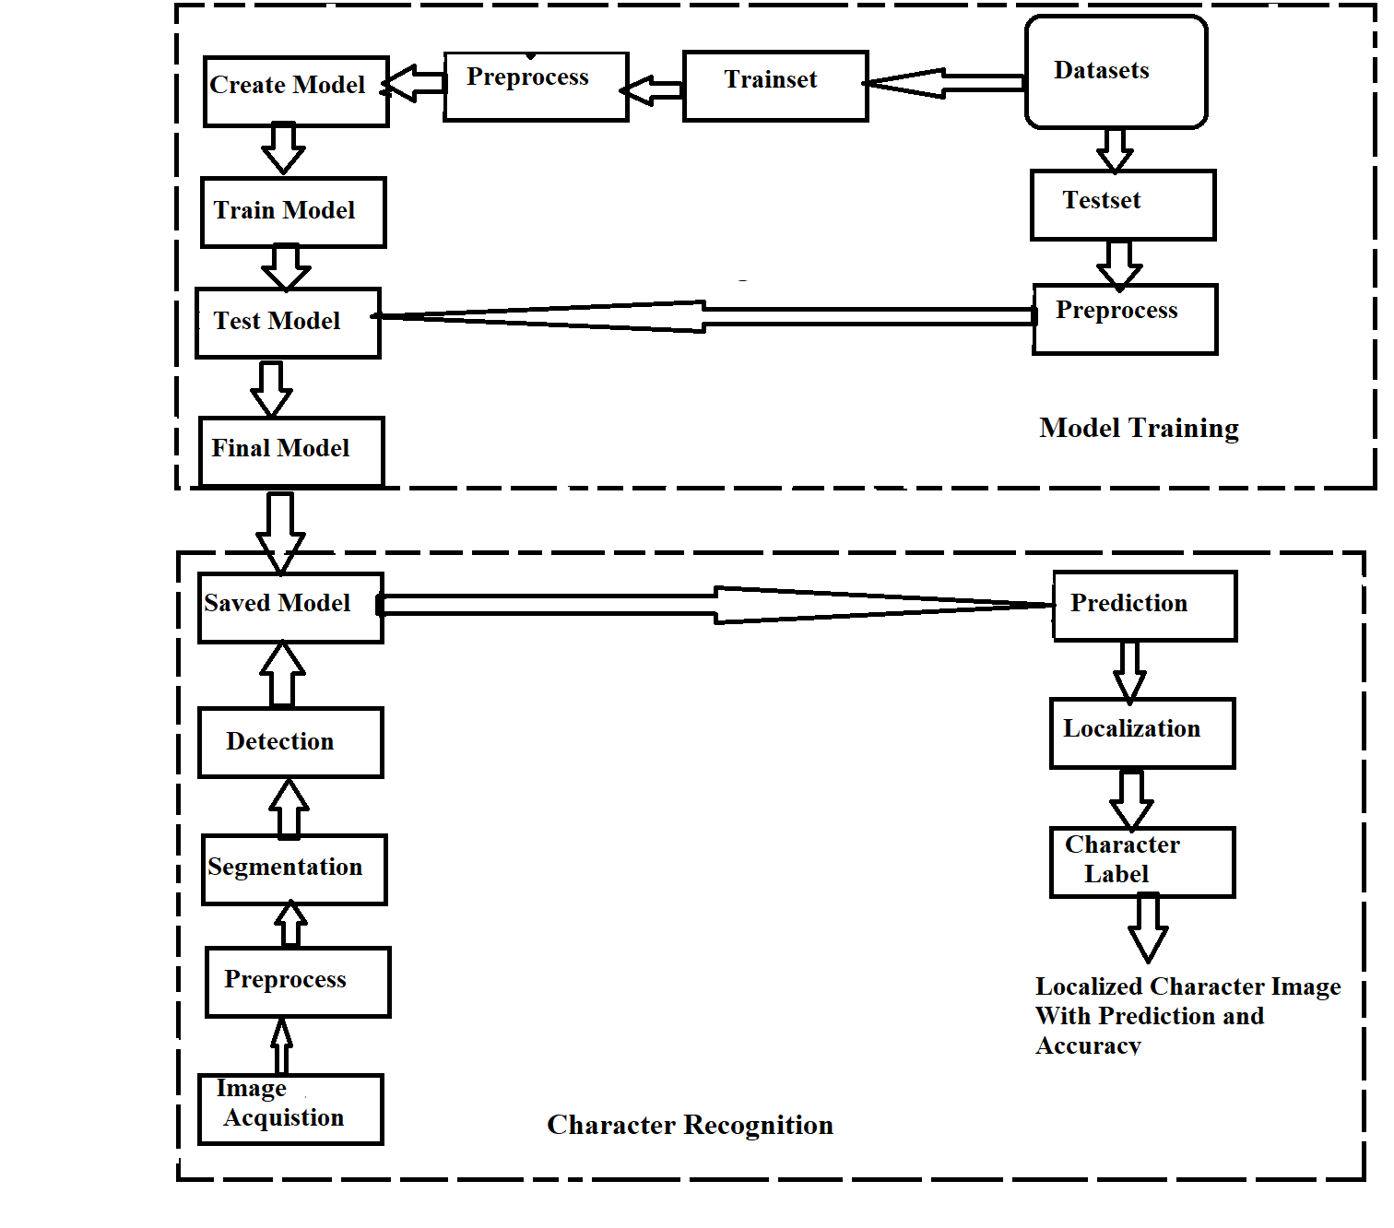
System Flow Diagram

Slide 12
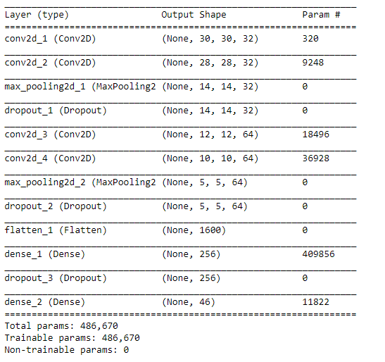
CNN Architecture
Input shape: (32, 32, 1)
Filter size: (3, 3)
Number of filters: 32
Pool size: (2, 2)
Activation function: ReLu on except final layer, Softmax on final layer
Dropout: 0.25 on inner and 0.5 on dense layer

Slide 13
Model Training
Loss: Categorical Cross Entropy
Optimizer: SGD
Batch size: 32
Epochs: 100
Validation split: 0.2
Train time: 37.86 minutes on Google Colab
Test accuracy: 99.29%

Slide 14
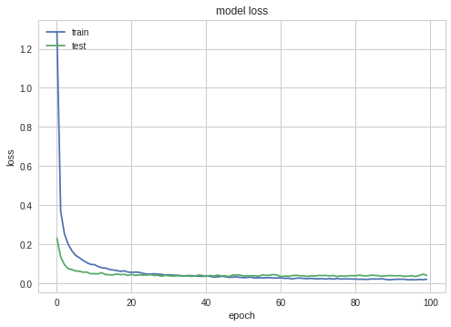
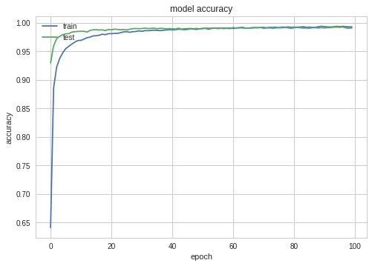
Training Visualization

Slide 15
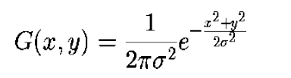
Pre-processing
The process of smoothing the data by removing the noise is pre-processing
Gaussian low pass filter is used to remove noise and smooth the data
The equation for the Gaussian low pass filter is
where, σ is the standard deviation of the distribution
Applying Binary thresholding and Otsu’s thresholding in smoothen image to get binary image

Slide 16
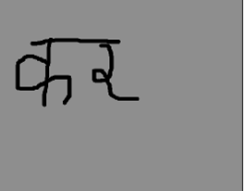
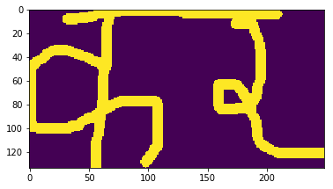
Feature Extraction
Extracting the features from the input samples
Features are number of width height ratio, foreground and background color, border, distance between border and character

Slide 17
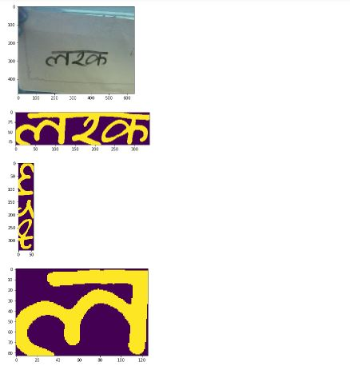
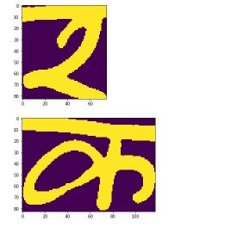
Segmentation
To check if there are multiple characters present or not, break the entire image into small fragments

Slide 18
Segmentation Algorithm
Step 1: Start.
Step 2: Get the cropped image.
Step 3: Eliminate the 31% of initial rows to remove the “dika” from image.
Step 4: Rotate the image towards right direction.
Step 5: Find the segmenting rows between two characters by checking the block
of rows.
Step 6: Find the segments in original cropped image using segmenting rows.
Step 7: Crop the each segments to get the area of interest.
Step 8: Return the segments.
Step 9: Stop.

Slide 19
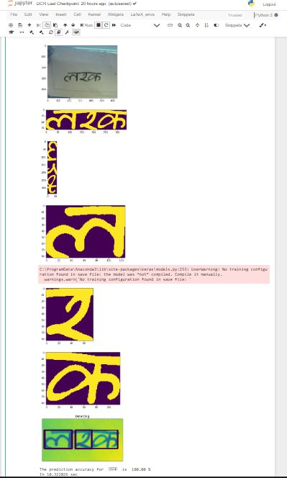
Overall Image Processing

Slide 20
Limitation
Quality of real world image directly affects in recognition process
Cannot recognize complex characters
Language dependent
Time consuming

Slide 21
Future Recommendation
Characters with modifiers can be implemented
Recognition of complex words, lines and paragraph
Can be used as a keyboard with simple gesture input
Can be implemented in other different language
Can be implemented in android, web, desktop application.

Slide 22
Thank You!

